Slide 1
Lab #2
Soldering

Slide 2
Intro
In this lab you’ll develop the skills needed to create and inspect reliable through-hole solder joints for electronic components, while applying proper tool handling and safety practices.
Intro
Reference
Task 1
Task 2
Turn-in Reqt’s
Authorized Resources
This is a team effort lab
External resources should not be necessary, but you may use:
Any non-human resource
Generative AI Level 4 Allowed
Astro 331 course instructor
Spacecraft and satellite electronics require exceptionally reliable solder joints that can withstand extreme vibration, temperature swings, and vacuum conditions.
By learning proper soldering techniques, you’ll gain a practical understanding of how flight-worthy digital system hardware is produced and appreciate how small workmanship errors can compromise mission success.
Objectives:
Identify the tools, materials, and safety equipment required for through-hole soldering.
Demonstrate proper soldering iron handling techniques, including tip cleaning and temperature control.
Prepare component leads and PCB pads for soldering by cleaning, tinning, and positioning.
Produce reliable solder joints for both through-hole and surface-mount components according to IPC standards.
Inspect solder joints using visual inspection to detect common defects (e.g., cold joints, bridges, insufficient wetting).
Apply safe work practices to prevent injury, equipment damage, or PCB overheating.

Slide 3
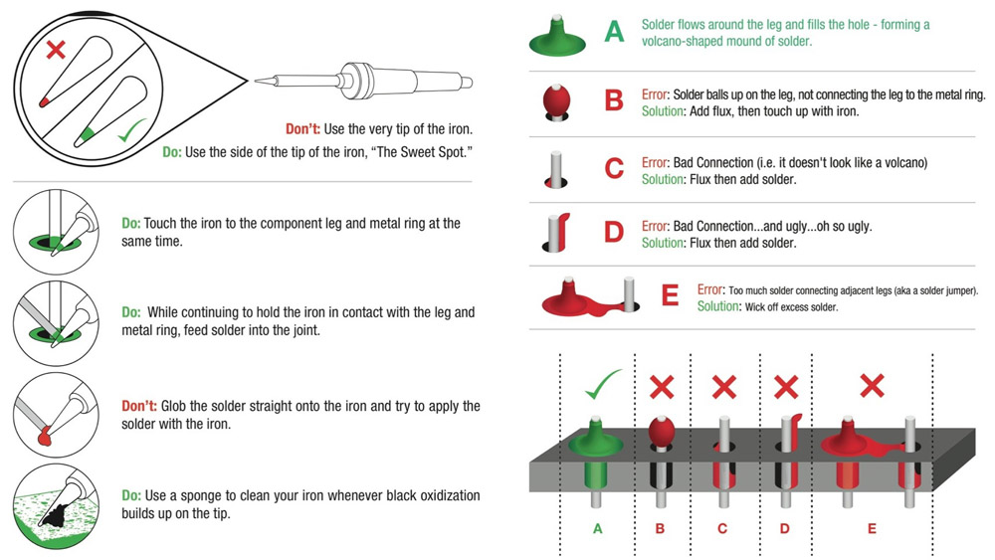
Soldering Reference
Soldering Basics | Soldering for Beginners (https://youtu.be/-qk-ulz05J8)
Soldering Through Hole Components (https://youtu.be/eHu_fGAyNY4)
Intro
Reference
Task 1
Task 2
Turn-in Reqt’s

Slide 4
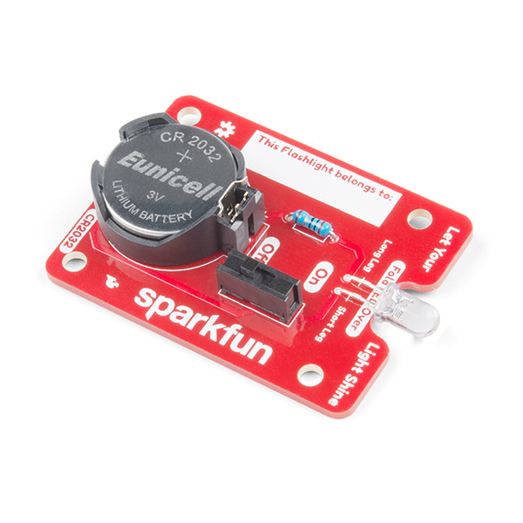
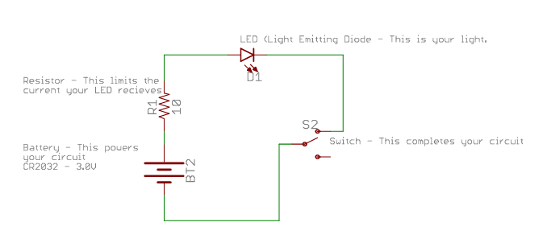
Task 1 – LED Flashlight
Intro
Reference
Task 1
Task 2
Turn-in Reqt’s
In this task, each team member will assemble their own Sparkfun LED flashlight.
Instructions: https://learn.sparkfun.com/tutorials/flashlight-kit
(PDF also available in Lab 2 folder)

Slide 5
Turn-In Requirements
Intro
Reference
Task 1
Task 2
Turn-in Reqt’s
Demonstrate to your instructor that:
Each team member’s flashlight has good solder joints and is functional

Slide 6
Deprecated Slides
(For reference only)

Slide 7
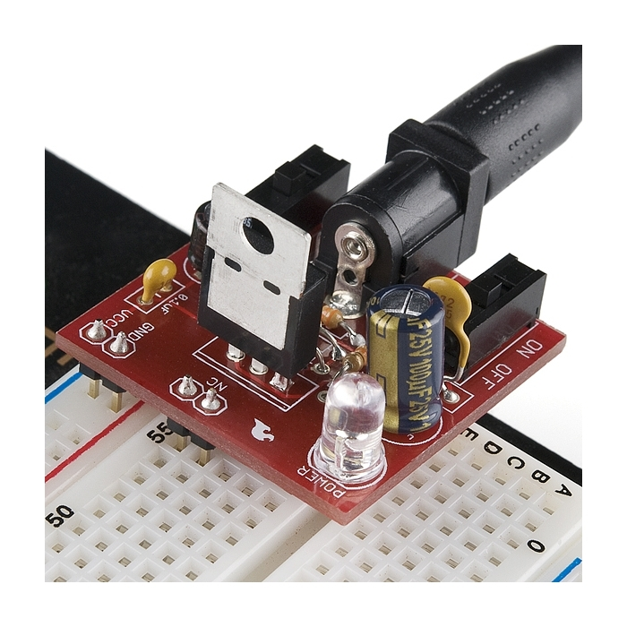
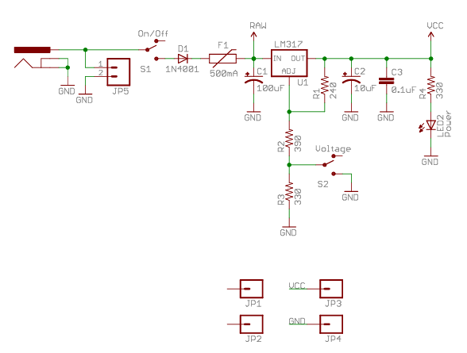
Task 2 – KestrelSAT 5V Regulator
In this task, each team will assemble a 5V power regulator. This regulator will be used on the team’s KestrelSAT during future labs.
Intro
Reference
Task 1
Task 2
Turn-in Reqt’s
KestrelSAT uses a Low Dropout Regulator (LDO) to step-down voltage from the 12V provided by the main battery to 5V needed to power the MCU and other devices.
Fuse
Reverse polarity protection diode
Power LED
LDO*
Product Page
Note
A Low Dropout Regulator (LDO) is a voltage regulator that can maintain a stable output voltage even when the input voltage is only slightly higher than the output. It is commonly used in embedded systems to provide clean, low-noise power to sensitive electronics.
Note that LDO’s have lower efficiency when the input voltage is significantly higher than the output, as excess voltage is dissipated as heat. This can lead to thermal issues,and reduced battery life in portable systems.
Voltage Input Connector
Noise Filtering Capacitors
Voltage Selector
Schematic
Voltage Output Pins
*LM317 Datasheet available in lab folder
Notes:
https://www.sparkfun.com/sparkfun-breadboard-power-supply-5v-3-3v.html

Slide 8
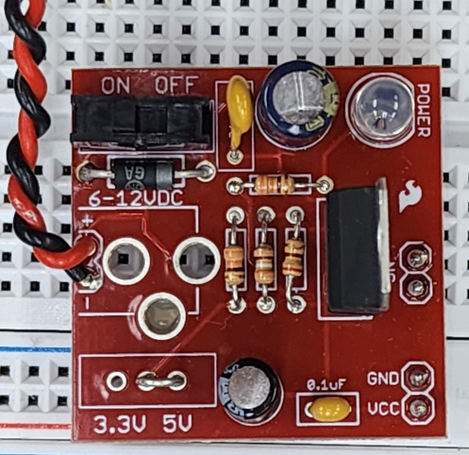
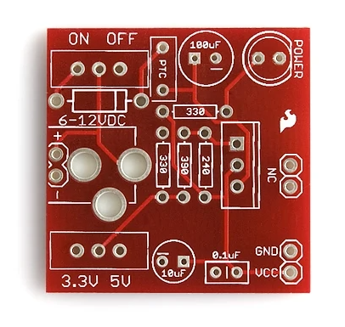
Task 2 (2) – KestrelSAT 5V Regulator
(1) Assemble your team’s 5V regulator as shown in the picture below.
**There are some modifications as compared to the version shown on the Sparkfun product page. You will have some parts left over.**
**Make sure to populate the board with correct resistors: use a multimeter to confirm that the resistance of a resistor corresponds to the number shown for that part on the PCB**
(2) Connect the input wires of your assembled regulator to your lab station’s power supply set to 12V.
(3) Turn on your regular via the power switch and verify the board power LED illuminates.
(4) Use a multimeter to verify that your regulator outputs 5V +/- 0.1V
Intro
Reference
Task 1
Task 2
Turn-in Reqt’s

